Slide 1
Virtual Memory
Lecturer: Li Yang
Contact: liyang23@swjtu.edu.cn
Office: X31506
Faculty: Computer and AI

Slide 2
Outline
Hardware and Control Structure
  Locality and Virtual Memory
  Paging
  Segmentation
  Combined Paging and Segmentation
  Protection and Sharing
Operating System Software
  Fetch Policy
  Placement Policy
  Replacement Policy
  Resident Set Management
  Cleaning Policy
  Load Control

Slide 3
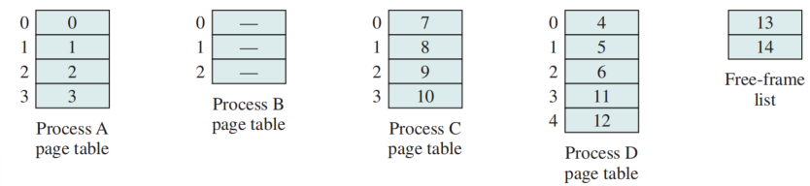
Page Table
Maintained by operating system for each process
Contains the frame location for each page in the process
Processor translate the logical address (page number, offset) to the physical address (frame number, offset)
Data Structures for the Example

Slide 4
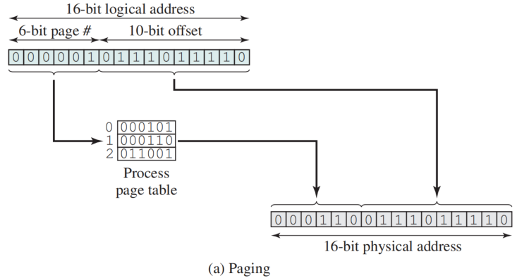
Logical-to-Physical Address Translation - Paging

Slide 5
8.1 Hardware and Control Structures
Several characteristics fundamental of paging and segmentation:
  all memory references are logical addresses that are dynamically translated into physical addresses at run time—— swapped in and out of main memory
  a process may be broken up into a number of pieces that don’t need to be contiguously located in main memory during execution
  it is not necessary that all of the pages or segments of a process be in main memory during execution

Slide 6
Execution of a Process
Operating system brings into main memory a few pieces of the program
An interrupt is generated when an logical address is needed that is not in main memory
Operating system places the process in a blocking state
Piece of process that contains the logical address is brought into main memory

Slide 7
Benefits
More processes may be maintained in main memory
  Only load in pieces of each process, there is room for more processes
  More efficient utilization of CPU: it is more likely that at least one of more process will be in the Ready state
  A process may be larger than all of main memory
  If the program being written is too large, the programmer must devise ways to structure the program into pieces that can be loaded separately in some sort of overlay strategy

Slide 8
Real and Virtual Memory
Real memory
  main memory, the actual RAM
Virtual memory
  memory on disk
  allows for effective multiprogramming and relieves the user of tight constraints of main memory

Slide 9
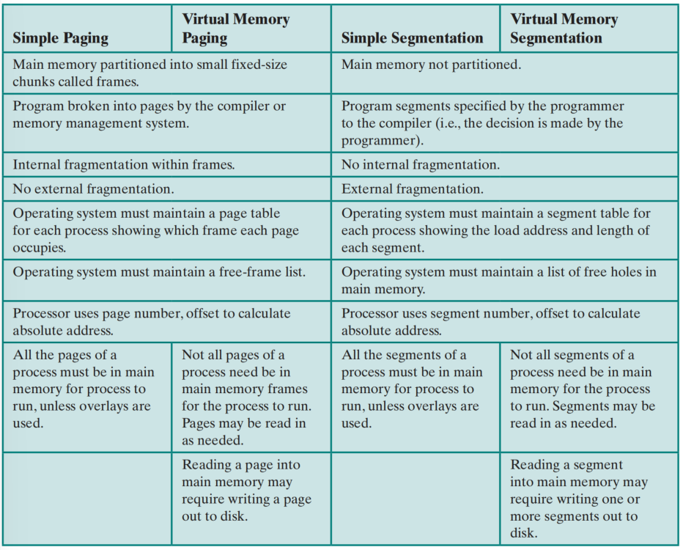
Characteristics of Paging and Segmentation

Slide 10
virtual memory paging
Main memory is divided into a number of equal size frames.
Each process is divided into a number of equal-size pages of the same length as frames.
Not all pages need to be loaded into main memory frames for execution
Each process has its own page table
  Each page table entry (页表项) contains the frame number of the corresponding page in main memory

Slide 11
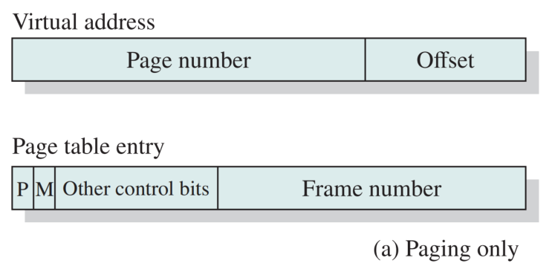
Memory Management Formats
P bit: indicate whether the corresponding page is present;
M bit： indicate whether the contents of the corresponding page have been modified
Other control bits: such as protection or sharing is managing at page level

Slide 12
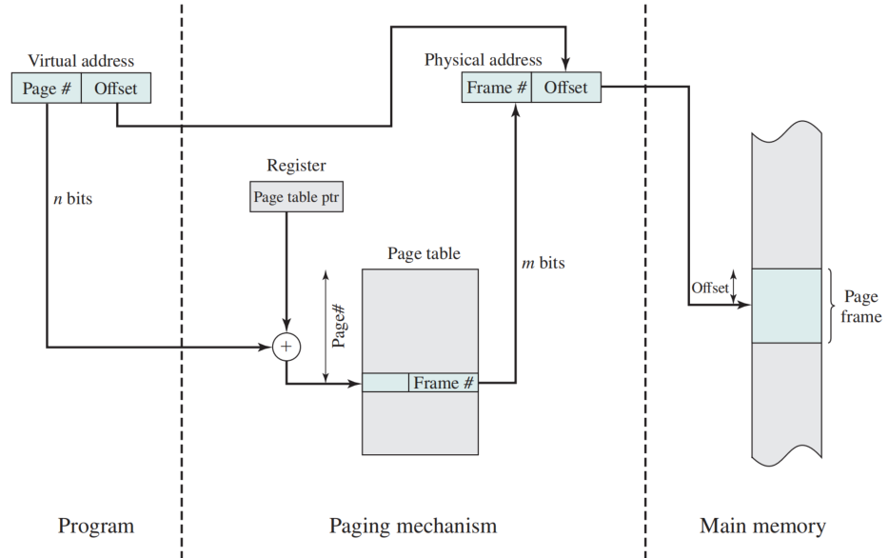
Address Translation in a Paging System
a register holds the starting address of the page table for that process.

Slide 13
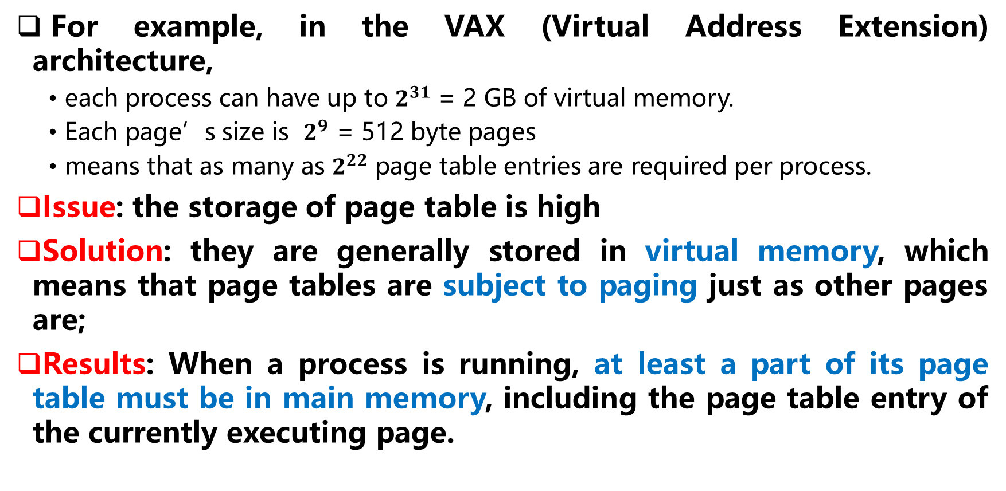
Storage of Page Table
For example, in the VAX (Virtual Address Extension) architecture,
  each process can have up to $2^{31}$ = 2 GB of virtual memory.
  Each page’s size is $2^{9}$ = 512 byte pages
  means that as many as $2^{22}$ page table entries are required per process.
Issue: the storage of page table is high
Solution: they are generally stored in virtual memory, which means that page tables are subject to paging just as other pages are;
Results: When a process is running, at least a part of its page table must be in main memory, including the page table entry of the currently executing page.

Slide 14
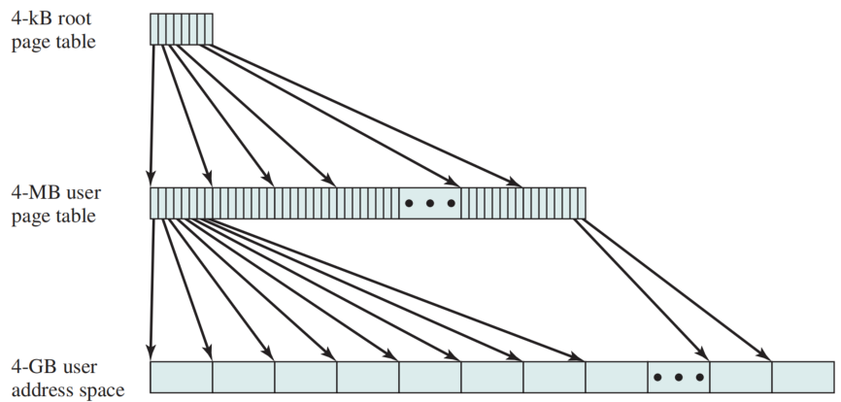
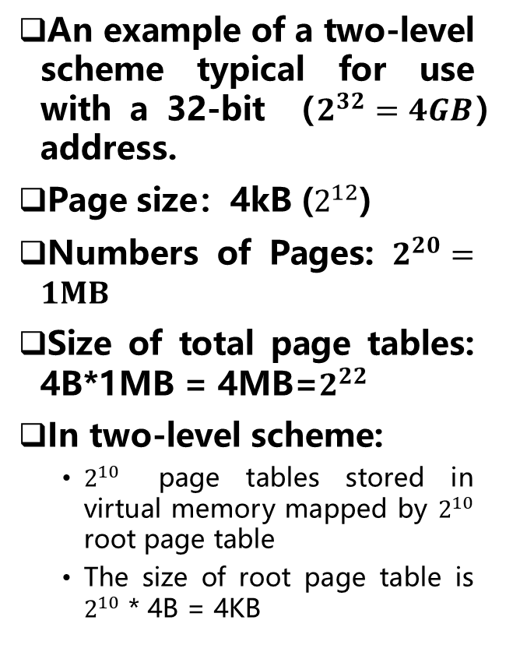
Two-Level Hierarchical Page Table（二级页表）
An example of a two-level scheme typical for use with a 32-bit （$2^{32}=4GB$）address.
Page size：4kB ($2^{12}$)
Numbers of Pages: $2^{20}=1MB$
Size of total page tables: 4B*1MB = 4MB=$2^{22}$
In two-level scheme:
  $2^{10}$ page tables stored in virtual memory mapped by $2^{10}$ root page table
  The size of root page table is $2^{10}$ * 4B = 4KB

Slide 15
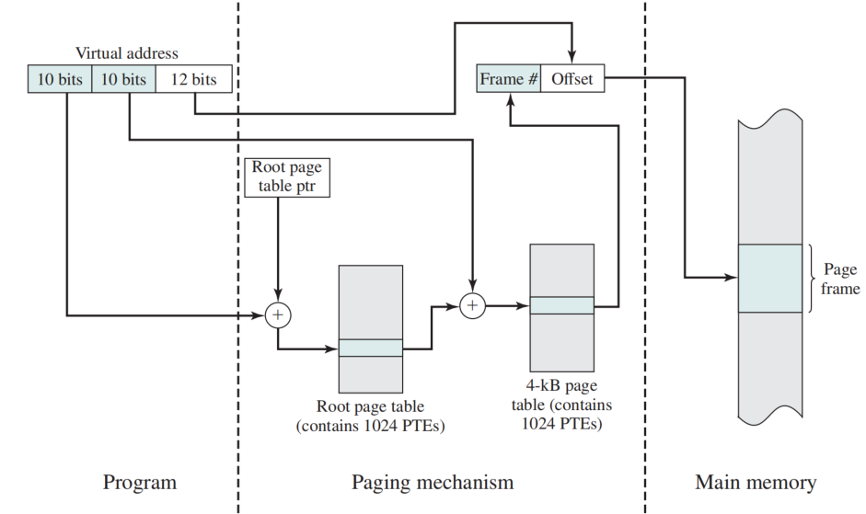
Address Translation in a Two-Level Paging System

Slide 16
Inverted Page Table（倒排页表）
Issue of above page tables: their size is proportional to that of the virtual address space
Solution: one of multi-level page tables——inverted page table
  N Page number portion of a virtual address is mapped into M hash value using a simple hashing function
  hash value points to inverted page table containing the page table entries
Fixed proportion of real memory is required for the inverted page tables

Slide 17
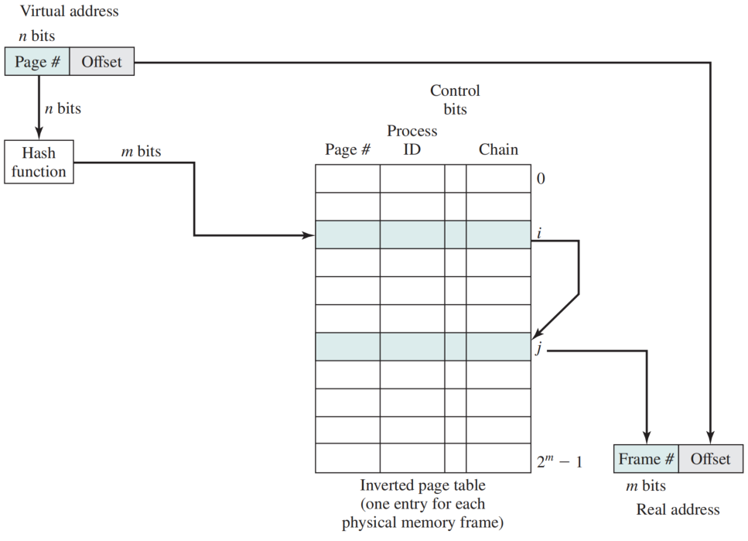
Inverted Page Table
Each entry in the page table includes:
  Page number
  Process identifier
  Control bits
    flags and protection and locking information
  Chain pointer
    the index value of the next entry in the chain

Slide 18
Translation Lookaside Buffer (转换检测缓存)
Each virtual memory reference can cause two physical memory accesses:
  one to fetch the page table entry
  one to fetch the data
To overcome the effect of doubling the memory access time, most virtual memory schemes make use of a special high-speed cache called a translation lookaside buffer （TLB）
  contains those page table entries that have been most recently used

Slide 19
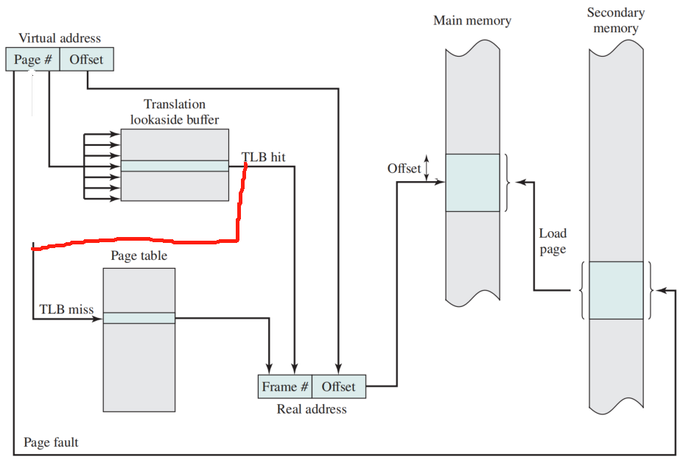
Use of a TLB

Slide 20
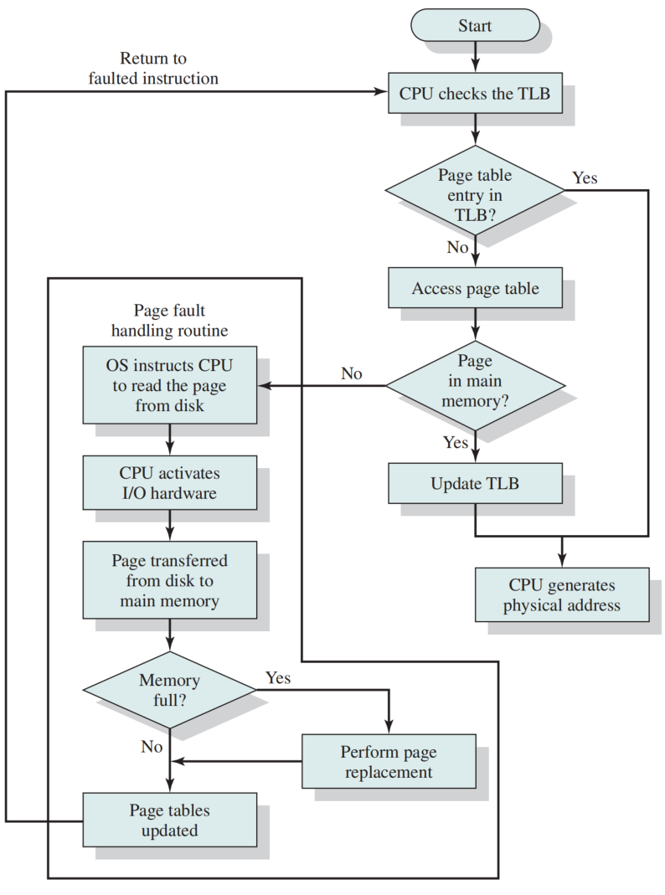
Operation of Paging and TLB

Slide 21
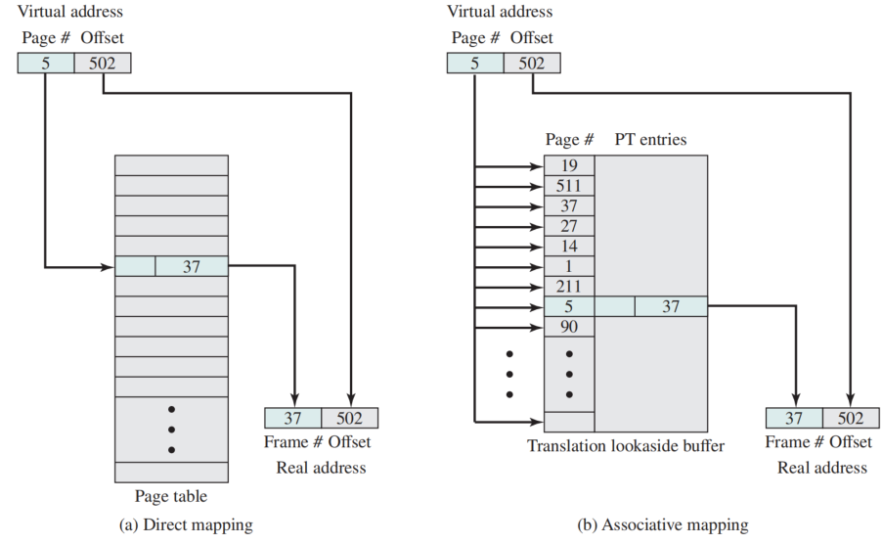
Associative Mapping（关联映射）
Direct versus Associative Lookup for Page Table Entries

Slide 22
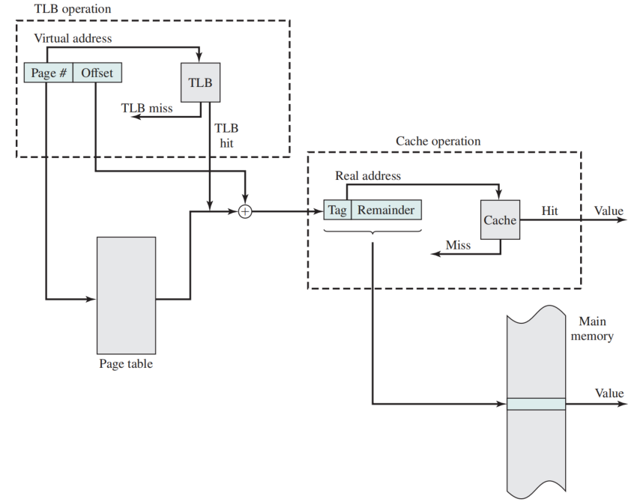
TLB and Cache Operation

Slide 23
Page Size
Objects: reduce internal fragmentation
  The smaller the page size, the lesser the amount of internal fragmentation
Constraints: smaller the page,
  more pages are required per process
  more pages per process means larger page tables
  some portion of the page tables of active processes must be in virtual memory instead of main memory
  a double page fault for a single reference to memory

Slide 24
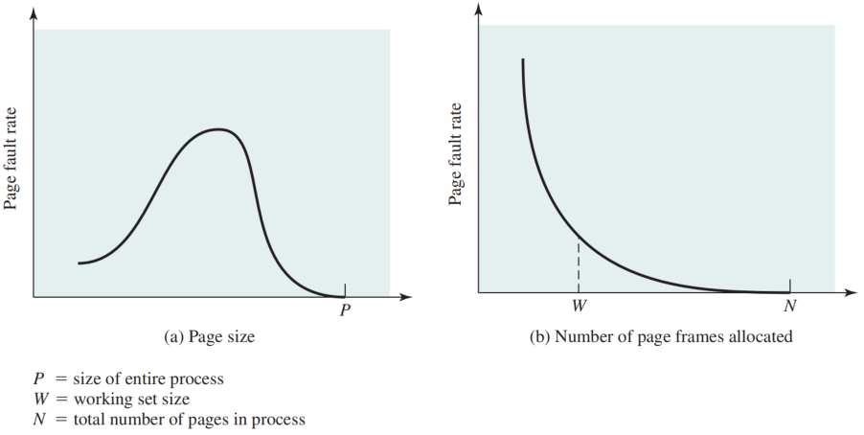
Typical Paging Behavior of a Program

Slide 25
Virtual Memory Segmentation
Segmentation allows the programmer to view memory as consisting of multiple address spaces or segments.
Segments may be of unequal, indeed dynamic, size.
Advantages:
  simplifies handling of growing data structures
  allows programs to be altered and recompiled independently
  lends itself to sharing data among processes
  lends itself to protection

Slide 26
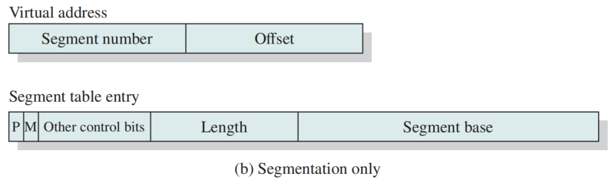
Segment Organization
Each segment table entry contains the starting address of the corresponding segment in main memory and the length of the segment
A bit (P) is needed to determine if the segment is already in main memory
Another bit (M) is needed to determine if the segment has been modified since it was loaded in main memory

Slide 27
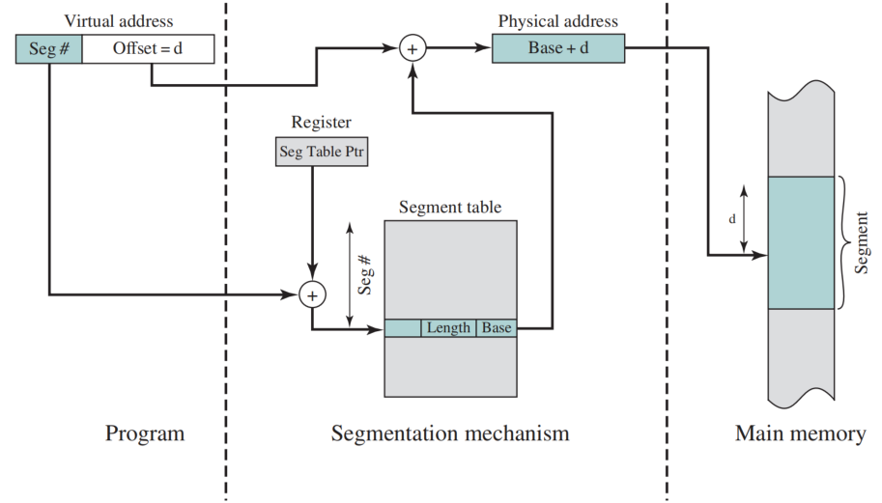
Address Translation in a Segmentation System

Slide 28
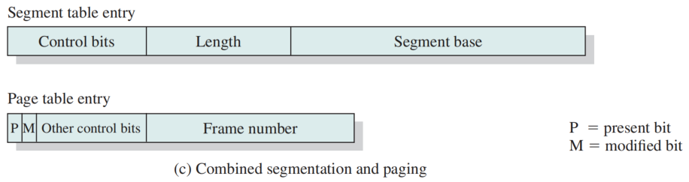
Combined Paging and Segmentation
In a combined paging/segmentation system a user’s address space is broken up into a number of segments. Each segment is broken up into a number of fixed-sized pages which are equal in length to a main memory frame
  Segmentation is visible to the programmer
  Paging is transparent to the programmer

Slide 29
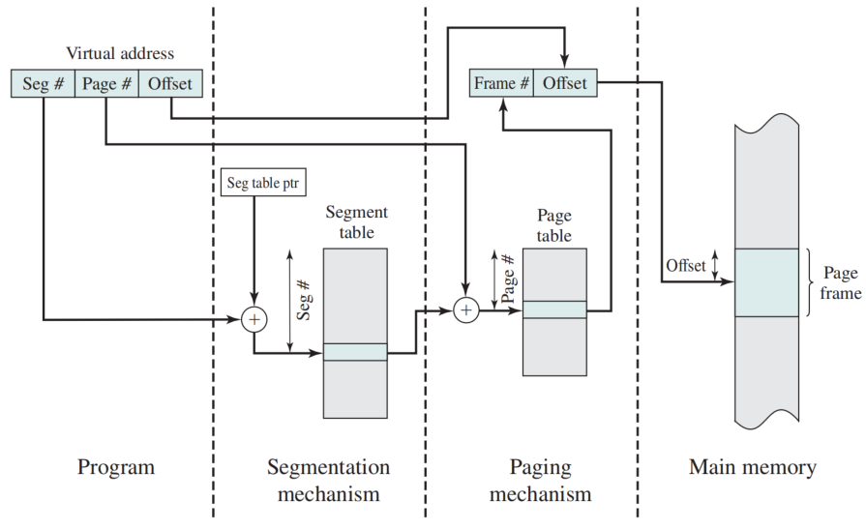
Address Translation in a Segmentation/Paging System

Slide 30
Summary
Principles of Locality
Real and Virtual Memory
Virtual Memory Paging
  Virtual address and page table entry
  Address translation
  two-level page table
  Inverted page table
  Translation lookaside buffer (TLB)
Virtual Memory Segmentation
Combined Paging and Segmentation
Protection and Sharing

Slide 31
Principle of Locality （局部性原理）
Definition of Thrashing
  when the OS brings one piece in, it must throw another out. If it throws out a piece just before it is used, then it will just have to go get that piece again almost immediately
  A state in which the system spends most of its time swapping process pieces rather than executing instructions
In essence, the OS tries to guess, based on recent history, which pieces are least likely to be used in the near future to avoids thrashing.
For virtual memory to be practical and effective, two ingredients are needed:
  be hardware support for the paging and/or segmentation scheme
  the OS must include software for managing the movement of pages and/or segments between secondary memory and main memory

